Slide 2
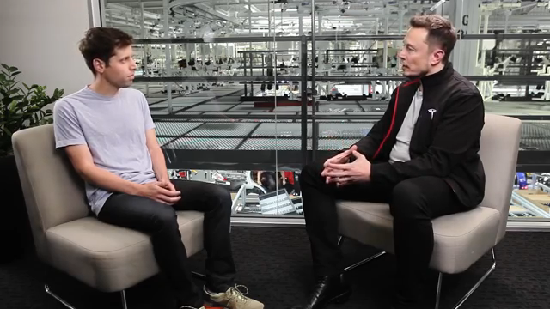

Slide 3
Who is this and what is he talking about?

Slide 4
Brain-Computer Interface (BCI)
Soumya Kundu and Christopher Oldham

Slide 5
BCI?

Slide 6
What are some current applications of BCI?

Slide 7
Current Applications of BCI

Slide 8
What could we do in the future?

Slide 9
Future applications of BCI

Slide 10
What problems might we have with our current BCI technology?

Slide 11
Current issues with BCI

Slide 12
How bad can it get?

Slide 13
Future issues with BCI

